Slide 1
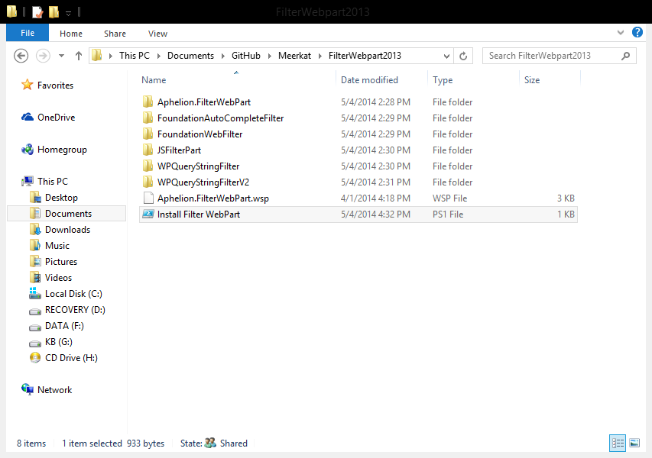
Access the Filter WebPart 2013 folder in Github and run the powershell script. The right values should be provided as the script runs.

Slide 2
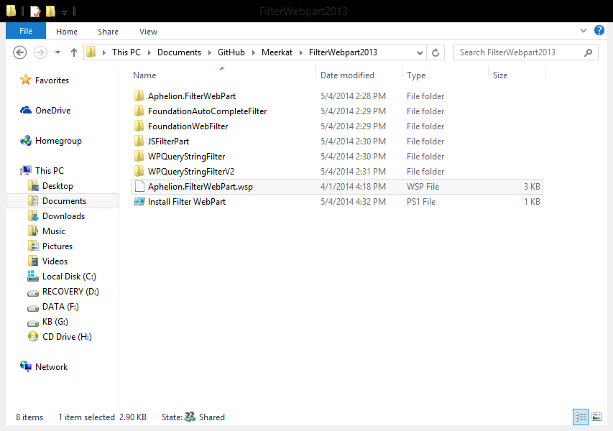
The solution file being used is “Aphelion.FilterWebPart.wsp” which is in the same location as the script as above.

